Slide 1

INTRODUCTION
Hello, I am OMKAR CHANCHLE
PHP/Laravel/Nodejs Developer since January 2021

Slide 2
FORTIFY LARAVEL WITH SPATIE

Slide 3
WHY SPATIE ?
Location: Spatie is based in Antwerp, Belgium, Since 2004.
10+ Years of Expertise: Over a decade of experience in the Laravel ecosystem,
delivering reliable and effective solutions.
Wide Range of Tools: Provides packages for both common and complex tasks.
Clear Documentation: Comprehensive and easy-to-follow guides that simplify integration and usage.
Active Community & Support: Regular updates and a vibrant community to provide support and share insights.
Prioritizes Security: Built-in features like role-based access control to ensure secure application development.
Scalable & Flexible: Solutions designed to grow with your app, from small projects to large enterprise systems.
Focus on Performance: Optimized tools and packages to help improve your application's speed and efficiency.
Open-Source & Free: All packages are free to use, with contributions from a broad developer community.

Slide 4


Slide 5
HOW TO FORTIFY LARAVEL WITH SPATIE ?
Spam prevention
CSP (Content Security Policy) enforcement
Auditing and tracking changes
Application health check
Server monitoring
Dependency vulnerability detection

Slide 6
THE SPATIE PACKAGES
spatie/laravel-honeypot: Deters spam bots with hidden form fields.
spatie/laravel-csp: Enforces security restrictions on loaded resources.
spatie/laravel-activitylog: Tracks model changes in your Laravel application,
providing an audit trail for debugging, monitoring, and security.
spatie/laravel-health: Monitors application health with custom checks.
spatie/security-advisories-health-check: Checks for security vulnerabilities in
dependencies.
spatie/laravel-server-monitor: Monitors server resources for performance issues.

Slide 7
WHAT THESE PACKAGEs PREVENT ?
spatie/laravel-honeypot: Mitigates spam and automated attacks.
spatie/laravel-csp: Prevents Cross-Site Scripting (XSS) attacks.
spatie/laravel-activitylog: Helps detect and investigate data breaches by
providing an audit trail of model changes.
spatie/laravel-health: It helps identify potential issues that could lead to
vulnerabilities.
spatie/security-advisories-health-check: Protects against vulnerabilities in
dependencies.
spatie/laravel-server-monitor: Helps prevent performance-related issues that could be
exploited by attackers.

Slide 8
MY WAY, HIGHWAY !
PRACTICAL DEMO
HOW TO DO !
HOW IT WORKS
Q & A

Slide 9
SPATIE/LARAVEL-HONEYPOT
Purpose:
Protects forms from spam submissions by bots.
Detects and filters out automated form submissions.
Implementation:
Adds a hidden honeypot field to your forms.
Bots are more likely to fill in this field, while humans typically ignore it.
Validates if the honeypot field is empty. If it's not empty, the submission is likely from a bot.
Benefits:
Reduces spam submissions significantly.
Improves form security and reduces the burden of spam filtering.
Easy to implement and integrate into existing Laravel projects

Slide 10
SPATIE/LARAVEL-CSP
Purpose:
Implements Content Security Policy (CSP) in your Laravel applications.
Enhances the security of your website by defining strict rules for the resources that can be loaded.
Features:
Easy configuration: Define CSP directives and their values through a simple configuration file.
Built-in directives: Supports a wide range of CSP directives for controlling scripts, styles, images, frames, and more.
Integrates seamlessly with Laravel's middleware system.
Benefits:
Prevents cross-site scripting (XSS), data injection attacks, and other threats.
Improves the overall security posture of your application.
Gives you fine-grained control over the resources that are loaded on your website.
Increases user trust and confidence in your website's security.

Slide 11
SPATIE/LARAVEL-ACTIVITYLOG
Purpose:
Tracks changes to models in your Laravel applications.
Improves security by providing an audit trail for detecting and investigating suspicious activities.
Features:
Easily log model creations, updates, and deletions.
Supports logging custom events and attributes.
Provides filtering and querying capabilities for audit logs.
Integrates seamlessly with Laravel's Eloquent ORM.
Benefits:
Detects and investigates data breaches and unauthorized modifications.
Aids in compliance with security and regulatory requirements.
Improves application stability by identifying and resolving issues quickly.
Enhances overall application security and accountability.

Slide 12
SPATIE/LARAVEL-HEALTH
Purpose:
Monitors the health status of your Laravel application and its
dependencies.
Provides a quick way to check if the application is running correctly.
Features:
Allows you to define custom health checks for various components (database,
cache, external services).
Provides a clear and concise health check endpoint.
Can be integrated with monitoring tools for proactive issue detection.
Benefits:
Proactively identifies and resolves issues before they impact users.
Improves application uptime and reliability.
Simplifies troubleshooting and debugging.

Slide 13
SPATIE/LARAVEL-SECURITY-ADVISORIES
Purpose:
Checks for known security vulnerabilities in your application’s
dependencies (e.g., Composer packages).
Features:
Integrates with security advisory databases (e.g., GitHub Advisories).
Identifies vulnerable packages in your project.
Provides information on the severity and potential impact of
vulnerabilities.
Benefits:
Improves application security by proactively addressing vulnerabilities.
Reduces the risk of exploitation by attackers.
Helps maintain the integrity and safety of your application.

Slide 14
SPATIE/LARAVEL-SERVER-MONITOR
Purpose:
Monitors server resources (CPU, memory, disk space) to ensure optimal performance.
Features:
Provides metrics on server resource usage.
Can be configured to trigger alerts based on specific thresholds.
Helps identify potential performance bottlenecks.
Benefits:
Prevents performance degradation and downtime due to resource constraints.
Improves application stability and responsiveness.
Provides valuable insights into server performance.

Slide 15
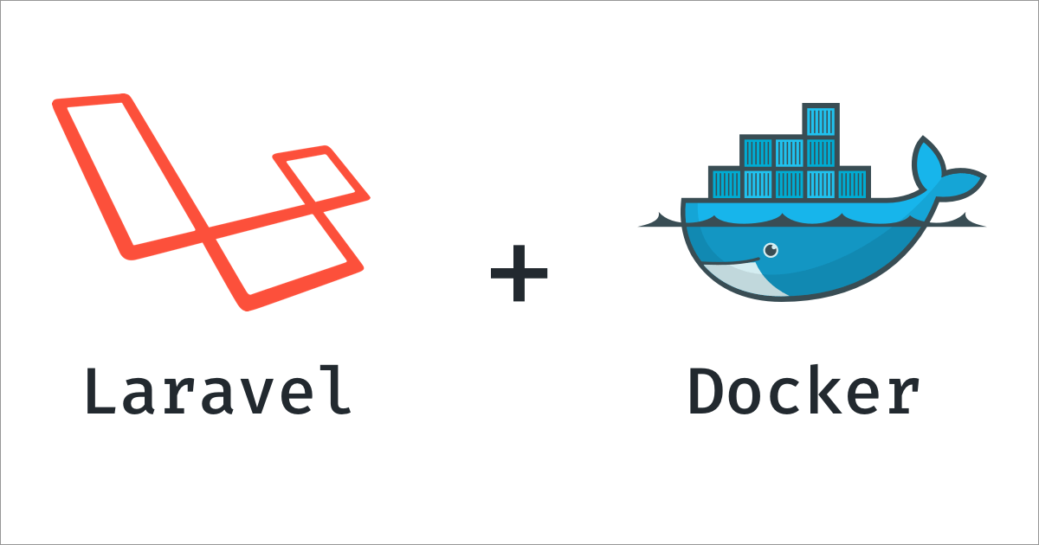
(LARAVEL + PHP + NODE) + DOCKER

